Slide 1
What’s In The News
Classification and Summarization of News Articles

Slide 2
“Simplicity is the ultimate complexity”
Notes:
Motivation
Project Questions
Datasets
Solutions
Findings and Results
Why does this matter?

Slide 3
What’s the Goals and Objectives
Develop a Web Application that allows a End User to:
Classify a New Article based on its textual contents
Summarize a New Article based on its textual contents
Look at some statistics of the textual contents
Combine the Data Science Workflow into an simple Application Development Workflow
Simplistic and straightforward

Slide 4
What’s the Deliverables
A Web Application
A Chrome Extension
Trained Models

Slide 5
Why News Articles?
News and blogs posts are easily available
Simple and easy to understand to proof of concept and learning
Can transfer learned NLP techniques with other document types

Slide 6
What’s The Value?
Trained models can save time for News Agencies to:
Automatically flag new contents
Automatically generate previews for listing on website
Web application can be extended and used to analyze different texts
Save time for readers to get quick insight from their news feed by getting to the main point (Summary)
Similar workflow can be used for automatic document classification and summarization in various business settings (Ex: Brief Clinical Notes, Legal Documents…)
Notes:
Expand on the value and problem to solve

Slide 7
What’s the Datasets Used
All The News 2.1 (From https://components.one)
Used for actual Model training
2.7 Million entries of News Articles from 27 Publishers
From 2013 – 2020
Only using a smaller subset (2018-2020) ~ 650K
BBC Articles
Used for learning and testing out stuff
Around 2000 entries of News Articles
From the BBC News only

Slide 8
What’s the Technology Used
NLP Vectorizer
TF-IDF with SK-Learn
Classification Models
Random Forest / Logistic Regression
KNN / Decision Tree / Gaussian Naïve Bayes
Summarization Models
T5 and Pegasus
Newspaper (Still undecided)

Slide 9
What’s The Performance
Classification Model | Accuracy | Precision | Recall
Random Forest
Logistic Regression
KNN
Decision Tree
Gaussian Naïve Bayes
Summarization Model | Bleu Score | Rouge Score
T5
Pegasus
Newspaper

Slide 10
What’s the Roadblocks and Challenges
Figuring out the actual map for ML Models on production
Dealing with an unclean yet large dataset
Some messy labeling pre-processing
Text exceeding maximum length for CSV (32K)
Leveraging cloud for training with big data
Articles can be an expiring dataset
Terms are time-sensitive (E.g. Brexit, Covid-19…)
Data Science workflow is quite non-linear
Unbalanced Dataset
Simplicity is the ultimate complexity
Notes:
Remove. Can throw in appendix

Slide 11
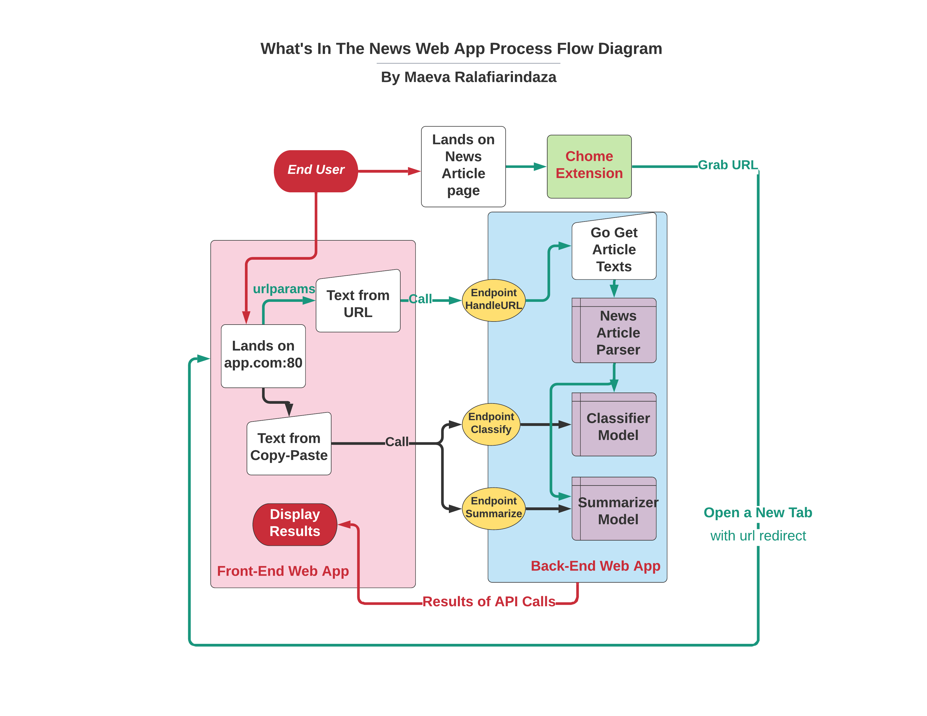
What’s The WebApp Design
Notes:
Remove. Can throw in appendix

Slide 12
Let’s Look At The Solution
Quick Web App Demo

